Slide 1
Session 11 - Strut

Slide 2
Agenda
Introduction to Strut
Advantages and Disadvantages of Struts
Processing Requests with Action Objects Struts: Flow of Control
  The six basic steps in using Struts
  Example: one result mapping - Same output page in all cases
  Example: multiple result mappings - Different output pages depending on the input
Handling Request Parameters with Form Beans: Flow of Control
  Automatically creating bean to represent request data
  Using bean:write to output bean properties

Slide 3
What is Apache Struts?
Struts provides a unified framework for deploying servlet and JSP applications that use the MVC architecture.
Struts provides utility classes to handle many of the most common tasks in Web application development
Struts provides custom tag libraries for outputting bean properties, generating HTML forms, iterating over various types of data structures, and conditionally outputting HTML.
The proper way to view Struts: depend on the using purpose, but the MVC framework is the most common way of looking at Struts.

Slide 4
Advantages of Struts (vs. MVC Using RequestDispatcher)
Centralized file-based configuration
  Replace hard-coding by representing by configuration files (XML or property files) → loose coupling → easy changing
Form beans
  In JSP, you can use property="*" with jsp:setProperty to automatically populate a JavaBean component based on incoming request parameters.
  Apache Struts extends this capability to Java code and adds in several useful utilities to simplify the processing of request parameters.
Bean tags
  Apache Struts provides a set of custom JSP tags (bean:write, in particular) that let you easily output the properties of JavaBeans components. Basically, these are concise and powerful variations of the standard jsp:useBean and jsp:getProperty tags.

Slide 5
Advantages of Struts (vs. Standard MVC), Continued
HTML tags
  Apache Struts provides a set of custom JSP tags to create HTML forms that are associated with JavaBeans components.
Form field validation
  Apache Struts has builtin capabilities for checking that form values are in the required format. If values are missing or in an improper format, the form can be automatically redisplayed with error messages and with the previously entered values maintained.
Consistent approach
  Struts encourages consistent use of MVC throughout your application.

Slide 6
Disadvantages of Struts (vs. MVC)
Bigger learning curve
Worse documentation than JSP
Less transparent
  Harder to understand
  Harder to benchmark and optimize
Rigid approach
  The flip side of the benefit that Struts encourages a consistent approach to MVC is that Struts makes it difficult (but by no means impossible) to use other approaches.

Slide 7
Downloading and Configuring Struts
Download the Struts zip file
  Start at http://jakarta.apache.org/site/binindex.cgi, or follow the link from http://jakarta.apache.org/struts/.
Unzip into a directory of your choice
  For example, unzip into C:\jakarta-struts-1.2.4. I'll refer to this location as struts_install_dir.
Update your CLASSPATH
  Add struts_install_dir/lib/struts.jar to the CLASSPATH used by your compiler or IDE (not your server).
Install an XML parser
  If you have JDK 1.4 or Apache Tomcat, this step is not necessary, since they already come with an XML parser. But, if you use JDK 1.2 or 1.3 with another server, you might need to obtain the XML parsing libraries. Here are two good sources:
    http://xml.apache.org/
    http://java.sun.com/xml/

Slide 8
Testing Struts
Install struts-blank.war.
  Install the Web application from struts_install_dir/webapps/struts-blank.war on your server. For example, with Apache Tomcat, copy struts_install_dir/webapps/struts-blank.war to tomcat_install_dir/webapps/.
Start or restart the server.
  Most servers only recognize new Web apps when the server is started.
Access http://localhost/struts-blank/.
  This URL assumes you are running the server on your desktop and are using port 80. In general, access http://hostname:port/struts-blank/.

Slide 9
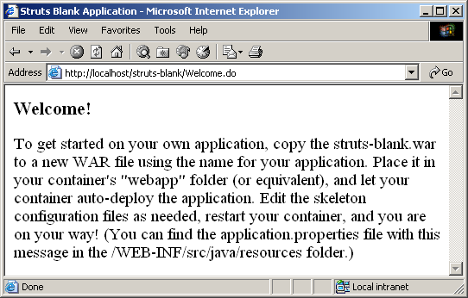
Testing Struts (Results)

Slide 10
Ten-Step Struts Development Plan
1. Gather and define the application requirements.
2. Define and develop each screen requirement in terms of the data collected and/or displayed.
3. Determine all the access paths for each screen.
4. Define the ActionMappings that correlate to the application business logic.
5. Create the ActionForms with defined properties from the screen requirements (this can include the validation portions as well).
6. Develop Actions to be called by the ActionMappings that, in turn, call the appropriatehelpers and forward to JSPs.
7. Develop the application business logic (Beans, EJBs, etc.).
8. Create JSPs to match the workflows using the ActionMappings.
9. Build the appropriate configuration files; this includes struts−config.xml and web.xml.
10. Build, test, deploy.

Slide 11

Processing Requests with Action Objects - Struts Flow of Control
JSP
struts-config.xml
request .../SomeForm.jsp
Determine
Action
Choose
JSP
Page
submit form
request .../blah.do
invoke
execute
method
Action
return condition
Form
return final result
forward to
JSP

Slide 12
Struts Flow of Control
The user requests a form
  For now, we use normal HTML to build the form
    Later we will use the Struts html:form tag
The form is submitted to a URL of the form blah.do.
  That address is mapped by struts-config.xml to an Action class
The execute method of the Action object is invoked
  One of the arguments to execute is a form bean that is automatically created and whose properties are automatically populated with the incoming form data
  The Action object then invokes business logic and data-access logic, placing the results in normal beans stored in request, session, or application scope.
  The Action uses mapping.findForward to return a condition, and the conditions are mapped by struts-config.xml to various JSP pages.
Struts forwards request to the appropriate JSP page
  The page can use bean:write or the JSP 2.0 EL to output bean properties
  The page can use bean:message to output fixed strings

Slide 13
The Six Basic Steps in Using Struts
Modify struts-config.xml.
Use WEB-INF/struts-config.xml to:
  Map incoming .do addresses to Action classes
  Map return conditions to JSP pages
  Declare any form beans that are being used.
  Be sure to restart the server after modifying
  struts-config.xml; the file is read only when the Web application is first loaded.
Define a form bean.
  This bean is a class the extends ActionForm and will represent the data submitted by the user. It is automatically populated when the input form is submitted. Beans are postponed until the next section.

Slide 14
The Six Basic Steps in Using Struts
Create results beans.
  In the MVC architecture, the business-logic and data-access code create the results and the JSP pages present them. To transfer the results from one layer to the other, they are stored in beans. These beans differ from form beans in that they need extend no particular class, and they represent the output of the computational process, not the input to the process. Beans will be discussed in the next section.
Define an Action class to handle requests.
  The struts-config.xml file designates the Action classes that handle requests for various URLs. The Action objects themselves need to do the real work: invoke the appropriate business- and data-access-logic, store the results in beans, and designate the type of situation (missing data, database error, success category 1, success category 2, etc.) that is appropriate for the results. The struts-config.xml file then decides which JSP page should apply to that situation.

Slide 15
The Six Basic Steps in Using Struts
Create form that invokes blah.do.
  Create an input form whose ACTION corresponds to one of the .do addresses listed in struts-config.xml.
  In a later lecture, we will discuss the advantages of using the Struts html:form tag to build this input form.
Display results in JSP.
  Since Struts is built around MVC, these JSP pages should avoid JSP scripting elements whenever possible. For basic Struts, these pages usually use the bean:write tag, but in JSP 2.0 the JSP 2.0 expression language is a viable alternative.
  In most cases, the JSP pages only make sense when the request is funneled through the Action, so the pages go in WEB-INF.
  If the JSP pages makes sense independently of the Action (e.g., if they display session data), then the JSP pages should be placed in a regular subdirectory of the Web application, and the forward entries in struts-config.xml should say
  <forward ... redirect="true"/>.

Slide 16
Example 1: One Result Mapping
URL
  http://hostname/struts-actions/register1.do
Action Class
  RegisterAction1
    RegisterAction1 extends Action and is in the coreservlets package.
    The execute method of RegisterAction1 always returns "success"
Results page
  /WEB-INF/results/confirm.jsp
    But the URL shown will still be register1.do

Slide 17
Step 1A (Modify struts-config.xml)
Map incoming .do addresses to Action classes
  In this case, we designate that RegisterAction1 should handle requests for register1.do. To accomplish this, we add an action entry to action-mappings, where action has the following attributes.
    path: the relative path that should be mapped to the Action, minus the .do extension. Thus, path="/register1" refers to http://hostname/webAppName/register1.do.
    type: the fully qualified class name of the Action class that should be invoked when a request for the path is received.
<action-mappings>
<!-- .do implied automatically -->
<action path="/register1"
type="coreservlets.RegisterAction1">
...
</action>
</action-mappings>

Slide 18
Step 1B (Modify struts-config.xml)
Map return conditions to JSP pages
  In this case, we use the forward element to say that confirm.jsp applies when the execute method of RegisterAction1 returns "success", as follows:
  <forward name="success"
  path="/WEB-INF/results/confirm.jsp"/>
  Note: if the same forward is used by multiple actions, you can put the forward declaration in a global-forwards section (before action-mappings) instead of in the action.
  <global-forwards>
  <forward name="success"
  path="/WEB-INF/results/confirm.jsp"/>
  </global-forwards>

Slide 19
Step 1 (Modify struts-config.xml) – Final struts-config.xml
<?xml version="1.0" encoding="ISO-8859-1" ?>
<!DOCTYPE struts-config PUBLIC ... >
<struts-config>
<action-mappings>
<action path="/register1"
type="coreservlets.RegisterAction1">
<forward name="success"
path="/WEB-INF/results/confirm.jsp"/>
</action>
</action-mappings>
</struts-config>

Slide 20
Steps 2 and 3
Define a form bean.
  Beans are postponed until the next section, so this step is omitted for now.
Create results beans.
  Beans are postponed until the next section, so this step is omitted for now.

Slide 21
Step 4 (Define an Action Class to Handle Requests)
Action subclasses should… be in a package.
  In this case, we have
  package coreservlets;
    This means that the class file should go in your_web_app/WEB-INF/classes/coreservlets/.
Action subclasses should… add Struts-specific import statements to whatever imports are otherwise needed.
  In this case, we have
  import javax.servlet.http.*;
  import org.apache.struts.action.*;

Slide 22
Step 4 (Define an Action Class to Handle Requests)
Action subclasses should ... extend Action
Action subclasses should ... override execute
  In this case, we have
public class RegisterAction1 extends Action {
public ActionForward
execute(ActionMapping mapping,
ActionForm form,
HttpServletRequest request,
HttpServletResponse response)
throws Exception {
...
}
}

Slide 23
Step 4 (Define an Action Class to Handle Requests)
Action subclasses should ... return mapping.findForward.
  The execute method should have one or more return values.
  These values will then be mapped to specific JSP pages by forward entries in struts-config.xml. In this case, we simply return "success" in all situations.
public ActionForward
execute(ActionMapping mapping,
ActionForm form,
HttpServletRequest request,
HttpServletResponse response)
throws Exception {
return(mapping.findForward("success"));
}

Slide 24
Step 4 (Define an Action Class to Handle Requests) – Final Code
package coreservlets;
import javax.servlet.http.*;
import org.apache.struts.action.*;
public class RegisterAction1 extends Action {
public ActionForward
execute(ActionMapping mapping,
ActionForm form,
HttpServletRequest request,
HttpServletResponse response)
throws Exception {
return(mapping.findForward("success"));
}
}

Slide 25
Step 5 (Create form that invokes blah.do)
We need an HTML form that invokes http://hostname/struts-actions/register1.do.
<!DOCTYPE ...>
<HTML>
<HEAD><TITLE>New Account Registration</TITLE></HEAD>
<BODY BGCOLOR="#FDF5E6">
<CENTER>
<H1>New Account Registration</H1>
<FORM ACTION="register1.do" METHOD="POST">
Email address: <INPUT TYPE="TEXT" NAME="email"><BR>
Password: <INPUT TYPE="PASSWORD" NAME="password"><BR>
<INPUT TYPE="SUBMIT" VALUE="Sign Me Up!">
</FORM>
</CENTER>
</BODY></HTML>

Slide 26
Step 6 (Display results in JSP)
In general, there can be several possible JSP pages
  Corresponding to the various possible return values of the execute method of the Action.
In struts-config.xml, each JSP page is declared in a forward entry within the appropriate action.
  In this simple case, the only return value is "success", so /WEB-INF/results/confirm.jsp is used in all cases.
This JSP page will just display a simple message (see next slide)

Slide 27
Step 6 (Display results in JSP) – Final Code
<!DOCTYPE ...>
<HTML>
<HEAD><TITLE>Success</TITLE></HEAD>
<BODY BGCOLOR="#FDF5E6">
<CENTER>
<H1>You have registered successfully.</H1>
Congratulations
</CENTER>
</BODY></HTML>

Slide 28
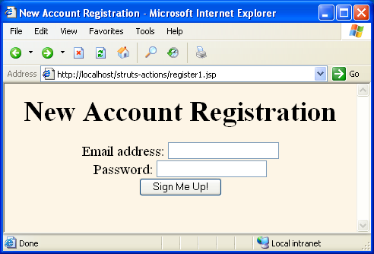
Example 1: Results
First, the HTML form is invoked with the URL http://localhost/struts-actions/register1.jsp

Slide 29
Example 1: Results
This form is then filled in and submitted,
  With the form's ACTION resulting in the URL http://localhost/struts-actions/register1.do.
This address is mapped by struts-config.xml
  To the RegisterAction1 class, whose execute method is invoked.
This method returns mapping.findForward
  With a value of "success"
That value is mapped by struts-config.xml
  To /WEB-INF/results/confirm.jsp,
    Which is the final result displayed to the user.
    However, since the JSP page is invoked with RequestDispatcher.forward, not response.sendRedirect, the URL displayed to the user is register1.do, not confirm.jsp.

Slide 30
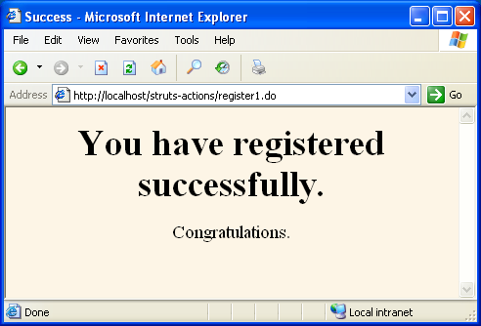
Example 1: Results

Slide 31
Example 2: Multiple Result Mappings
URL
  http://hostname/struts-actions/register2.do
Action Class
  RegisterAction2.
    The execute method of RegisterAction2 returns "success",
    "bad-address", or "bad-password"
Results pages
  /WEB-INF/results/confirm.jsp,
  /WEB-INF/results/bad-address.jsp, and
  /WEB-INF/results/bad-password.jsp, respectively.
Main new feature of this example
  The use of multiple forward entries within the action element.

Slide 32
Step 1 (Modify struts-config.xml)
Map incoming .do address to Action classes
  In this case, we use the action element to designate that RegisterAction2 should handle requests for register2.do (again, note that .do is implied, not listed explicitly).
Map return conditions to JSP pages
  In this case, we use multiple forward elements, one for each possible return value of the execute method of the RegisterAction2 class.
Declare any form beans that are being used.
  Beans are postponed until the next section, so this step is omitted for now.

Slide 33
Step 1 (Modify struts-config.xml) – Final Code
<?xml version="1.0" encoding="ISO-8859-1" ?>
<!DOCTYPE struts-config PUBLIC ... >
<struts-config>
<action-mappings>
...
<action path="/register2"
type="coreservlets.RegisterAction2">
<forward name="bad-address"
path="/WEB-INF/results/bad-address.jsp"/>
<forward name="bad-password"
path="/WEB-INF/results/bad-password.jsp"/>
<forward name="success"
path="/WEB-INF/results/confirm.jsp"/>
</action>
</action-mappings>
</struts-config>

Slide 34
Steps 2 and 3
Define a form bean.
  Beans are postponed until the next section, so this step is omitted for now.
Create results beans.
  Beans are postponed until the next section, so this step is omitted for now.

Slide 35
Step 4 (Define an Action Class to Handle Requests)
Similar to the previous example except for multiple mapping.findForward entries
  We return "bad-address" if the email address is missing, is less then three characters long, or does not contain an "@" sign.
  We return "bad-password" if the password is missing or is less than six characters long.
  Otherwise we return "success".
In this simple example we use request.getParameter explicitly.
  In later examples we let Struts automatically populate a bean from the request data.

Slide 36
Step 4 (Define an Action Class to Handle Requests) – Final Code
public class RegisterAction2 extends Action {
public ActionForward
execute(ActionMapping mapping,
ActionForm form,
HttpServletRequest request,
HttpServletResponse response)
throws Exception {
String email = request.getParameter("email");
String password = request.getParameter("password");
if ((email == null) ||
(email.trim().length() < 3) ||
(email.indexOf("@") == -1)) {
return(mapping.findForward("bad-address"));
} else if ((password == null) ||
(password.trim().length() < 6)) {
return(mapping.findForward("bad-password"));
} else {
return(mapping.findForward("success"));
}}}

Slide 37
Step 5 (Create Form that Invokes blah.do)
We need an HTML form that invokes http://hostname/struts-actions/register2.do.
<!DOCTYPE ...>
<HTML>
<HEAD><TITLE>New Account Registration</TITLE></HEAD>
<BODY BGCOLOR="#FDF5E6">
<CENTER>
<H1>New Account Registration</H1>
<FORM ACTION="register2.do" METHOD="POST">
Email address: <INPUT TYPE="TEXT" NAME="email"><BR>
Password: <INPUT TYPE="PASSWORD" NAME="password"><BR>
<INPUT TYPE="SUBMIT" VALUE="Sign Me Up!">
</FORM>
</CENTER>
</BODY></HTML>

Slide 38
Step 6 (Display results in JSP)
First Possible Page
<!DOCTYPE ...>
<HTML>
<HEAD><TITLE>Illegal Email Address</TITLE></HEAD>
<BODY BGCOLOR="#FDF5E6">
<CENTER>
<H1>Illegal Email Address</H1>
Address must be of the form username@host.
Please <A HREF="register2.jsp">
try again</A>.
</CENTER>
</BODY></HTML>

Slide 39
Step 6 (Display results in JSP)
Second Possible Page
<!DOCTYPE ...>
<HTML>
<HEAD><TITLE>Illegal Password</TITLE></HEAD>
<BODY BGCOLOR="#FDF5E6">
<CENTER>
<H1>Illegal Password</H1>
Password must contain at least six characters.
Please <A HREF="register2.jsp">
try again</A>.
</CENTER>
</BODY></HTML>

Slide 40
Step 6 (Display results in JSP)
Same confirm.jsp Shown Earlier
<!DOCTYPE ...>
<HTML>
<HEAD><TITLE>Success</TITLE></HEAD>
<BODY BGCOLOR="#FDF5E6">
<CENTER>
<H1>You have registered successfully.</H1>
Congratulations
</CENTER>
</BODY></HTML>

Slide 41
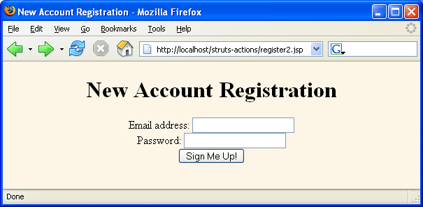
Example 2: Results (Initial Form)

Slide 42
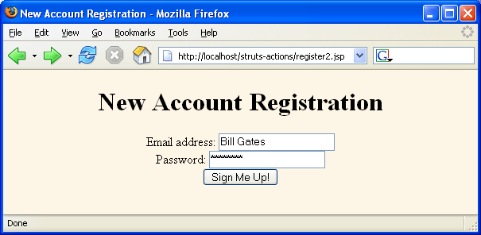
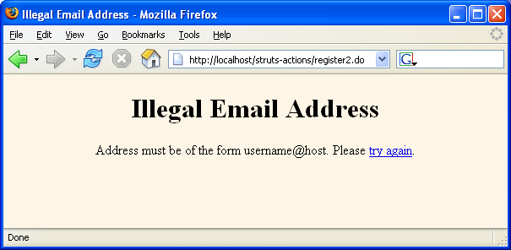
Example 2: Results (Bad Address)

Slide 43
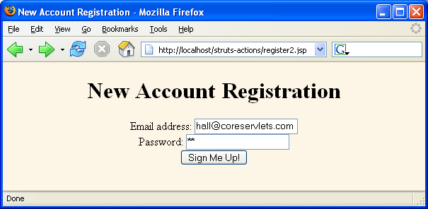
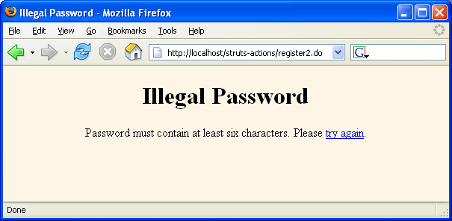
Example 2: Results
(Bad Password)

Slide 44
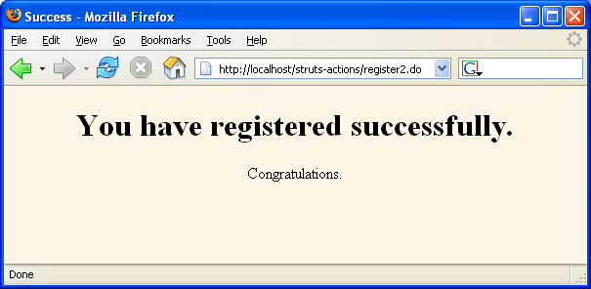
Example 2: Results (Success)

Slide 45
Combining Shared Condition (Forward) Mappings
Idea
  If the same condition is mapped to the same JSP page in multiple actions, you can move the forward to a global-forwards section to avoid repetition
Syntax
  The global-forwards section goes before
  action-mappings, not within it
  The forward entries within global-forwards have the same syntax and behavior as forward entries within action
Example
<global-forwards>
<forward name="success"
path="/WEB-INF/results/confirm.jsp"/>
</global-forwards>

Slide 46
Combining Shared Condition (Forward) Mappings: Old
<action-mappings>
<action path="/register1"
type="coreservlets.RegisterAction1">
<forward name="success"
path="/WEB-INF/results/confirm.jsp"/>
</action>
<action path="/register2"
type="coreservlets.RegisterAction2">
<forward name="bad-address"
path="/WEB-INF/results/bad-address.jsp"/>
<forward name="bad-password"
path="/WEB-INF/results/bad-password.jsp"/>
<forward name="success"
path="/WEB-INF/results/confirm.jsp"/>
</action>
...
</action-mappings>

Slide 47
Combining Shared Condition (Forward) Mappings: New
<global-forwards>
<forward name="success"
path="/WEB-INF/results/confirm.jsp"/>
</global-forwards>
<action-mappings>
<action path="/register1"
type="coreservlets.RegisterAction1">
</action>
<action path="/register2"
type="coreservlets.RegisterAction2">
<forward name="bad-address"
path="/WEB-INF/results/bad-address.jsp"/>
<forward name="bad-password"
path="/WEB-INF/results/bad-password.jsp"/>
</action>
...
</action-mappings>

Slide 48
Handling Request Parameters with Form Beans –
Struts Flow of Control
Populate bean based on request parameters. Supply as second argument to execute.
struts-config.xml
JSP
request .../SomeForm.jsp
Determine
Action
Choose
JSP
Page
submit form
request .../blah.do
invoke
execute
method
Action
return condition
Form
return final result
forward to
JSP
Use bean:write to output bean properties.

Slide 49
Struts Flow of Control
The user requests a form
  For now, we use normal HTML to build the form
    Later we will use the Struts html:form tag
The form is submitted to a URL of the form blah.do.
  That address is mapped by struts-config.xml to an Action class
The execute method of the Action object is invoked
  One of the arguments to execute is a form bean that is automatically created and whose properties are automatically populated based on incoming request parameters of the same name
  The Action object then invokes business logic and data-access logic, placing the results in normal beans stored in request, session, or application scope.
  The Action uses mapping.findForward to return a condition, and the conditions are mapped by struts-config.xml to various JSP pages.
Struts forwards request to the appropriate JSP page
  The page can use bean:write or the JSP 2.0 EL to output bean properties
  The page can also use bean:message to output fixed strings

Slide 50
New Capabilities
Defining a form bean
  Struts lets you define a bean that represents the incoming request data. Struts will create and populate the bean for you, and pass it to the Action as the second argument to the execute method.
    Bean must extend ActionForm
    Bean must be declared in struts-config.xml with form-beans
Outputting bean properties
  You can use the Struts bean:write tag to output bean properties in JSP pages.

Slide 51
The Six Basic Steps in Using Struts: Updates for Bean Use
Modify struts-config.xml.
Use WEB-INF/struts-config.xml to:
  Map incoming .do addresses to Action classes
  Map return conditions to JSP pages
  Declare any form beans that are being used.
  Restart server after modifying struts-config.xml.
Define a form bean.
  This bean extends ActionForm and represents the data submitted by the user. It is automatically populated when the input form is submitted. More precisely:
    The reset method is called (useful for session-scoped beans)
    For each incoming request parameter, the corresponding setter method is called
    The validate method is called (possibly preventing the Action)

Slide 52
The Six Basic Steps in Using Struts: Updates for Bean Use
Create results beans.
  These are normal beans of the sort used in MVC when implemented directly with RequestDispatcher. That is, they represent the results of the business logic and data access code. These beans are stored in request, session, or application scope with the setAttribute method of HttpServletRequest, HttpSession, or ServletContext, just as in normal non-Struts applications.
Define an Action class to handle requests.
  Rather than calling request.getParameter explicitly as in the previous example, the execute method casts the ActionForm argument to the specific form bean class, then uses getter methods to access the properties of the object.

Slide 53
The Six Basic Steps in Using Struts: Updates for Bean Use
Create form that invokes blah.do.
  For now, we will use static HTML
    Later, we will use the html:form tag to guarantee that the textfield names correspond to the bean property names, and to make it easy to fill in the form based on values in the app
    Later, we will also use bean:message to output fixed strings from a properties file
Display results in JSP.
  The JSP page uses the bean:write tag to output properties of the form and result beans.
  It may also use the bean:message tag to output standard messages and text labels that are defined in a properties file (resource bundle).

Slide 54
Example 1:
Form and Results Beans
URL
  http://hostname/struts-beans/register1.do
Action Class
  BeanRegisterAction
    Instead of reading form data explicitly with request.getParameter, the execute method uses a bean that is automatically filled in from the request data.
    As in the previous example, this method returns "success",
    "bad-address", or "bad-password"
Results pages
  /WEB-INF/results/confirm-registration1.jsp
  /WEB-INF/results/bad-address1.jsp
  /WEB-INF/results/bad-password1.jsp

Slide 55
New Features of This Example
The use of a bean to represent the incoming form data.
  This bean extends the ActionForm class, is declared in struts-config.xml with the form-bean tag, and is referenced in struts-config.xml with name and scope attributes in the action element.
The use of a regular bean to represent custom results.
  As with beans used with regular MVC, this bean need not extend any particular class and requires no special struts-config.xml declarations.
The use of the Struts bean:write tags to output bean properties in the JSP page that displays the final results.
  This is basically a more powerful and concise alternative to the standard jsp:getProperty tag. Before we use bean:write, we have to import the "bean" tag library as follows.
    <%@ taglib uri="http://struts.apache.org/tags-bean"
    prefix="bean" %>

Slide 56
Step 1
(Modify struts-config.xml)
Map incoming .do address to Action classes
  As before, we use the action element (to designate that BeanRegisterAction should handle requests for register1.do).
Map return conditions to JSP pages
  As before, we use multiple forward elements, one for each possible return value of the execute method
Declare any form beans that are being used.
  Use form-bean (within form-beans) with these two attributes:
    name: a name that will match the name attribute of the action element.
    type: the fully qualified classname of the bean.
  Note that the form-beans section goes before action-mappings in struts-config.xml, not inside action-mappings
  Here is an example:
    <form-beans>
    <form-bean name="userFormBean"
    type="coreservlets.UserFormBean"/>
    </form-beans>

Slide 57
Step 1 (Modify struts-config.xml), Continued
Update action declaration
  After declaring the bean in the form-beans section, you need to add two new attributes to the action element: name and scope
    name: a bean name matching the form-bean declaration.
    scope: request or session. Surprisingly, session is the default, but always explicitly list the scope anyhow. We want request here.
  Here is an example.
    <action path="/register1"
    type="coreservlets.BeanRegisterAction"
    name="userFormBean"
    scope="request">

Slide 58
Step 1 (Modify struts-config.xml) -- Final Code
<?xml version="1.0" encoding="ISO-8859-1" ?>
<!DOCTYPE struts-config PUBLIC ... >
<struts-config>
<form-beans>
<form-bean name="userFormBean"
type="coreservlets.UserFormBean"/>
</form-beans>
<action-mappings>
<action path="/register1"
type="coreservlets.BeanRegisterAction"
name="userFormBean"
scope="request">
<forward name="bad-address"
path="/WEB-INF/results/bad-address1.jsp"/>
<forward name="bad-password"
path="/WEB-INF/results/bad-password1.jsp"/>
<forward name="success"
path="/WEB-INF/results/confirm-registration1.jsp"/>
</action>
</action-mappings>
</struts-config>

Slide 59
Step 2 (Define a Form Bean)
A form bean is a Java object that will be automatically filled in based on the incoming form parameters, then passed to the execute method. Requirements:
  It must extend ActionForm.
    The argument to execute is of type ActionForm. Cast the value to your real type, and then each bean property has the value of the request parameter with the matching name.
  It must have a zero argument constructor.
    The system will automatically call this default constructor.
  It must have settable bean properties that correspond to the request parameter names.
    That is, it must have a setBlah method corresponding to each incoming request parameter named blah. The properties should be of type String (i.e., each setBlah method should take a String as an argument).
  It must have gettable bean properties for each property that you want to output in the JSP page.
    That is, it must have a getBlah method corresponding to each bean property that you want to display in JSP without using Java syntax.

Slide 60
Step 2 (Define a Form Bean) -- Code Example
package coreservlets;
import org.apache.struts.action.*;
public class UserFormBean extends ActionForm {
private String email = "Missing address";
private String password = "Missing password";
public String getEmail() { return(email); }
public void setEmail(String email) {
this.email = email;
}
public String getPassword() { return(password); }
public void setPassword(String password) {
this.password = password;
}
}

Slide 61
Step 3 (Create Results Beans)
These are normal beans of the type used in regular MVC (i.e., implemented with RequestDispatcher)
  The form bean represents the input data: the data that came from the HTML form. In most applications, the more important type of data is the result data: the data created by the business logic to represent the results of the computation or database lookup.
  Results beans need to have getter and setter methods like normal JavaBeans, but need not extend any particular class or be declared in struts-config.xml.
    They are stored in request, session, or application scope with the setAttribute method of HttpServletRequest, HttpSession, or ServletContext, respectively.

Slide 62
Step 3, Bean Code Example
package coreservlets;
public class SuggestionBean {
private String email;
private String password;
public SuggestionBean(String email, String password) {
this.email = email;
this.password = password;
}
public String getEmail() {
return(email);
}
public String getPassword() {
return(password);
}
}

Slide 63
Step 3, Business Logic Code
(To Build SuggestionBean)
package coreservlets;
public class SuggestionUtils {
private static String[] suggestedAddresses =
{ "president@whitehouse.gov",
"gates@microsoft.com",
"palmisano@ibm.com",
"ellison@oracle.com" };
private static String chars =
"abcdefghijklmnopqrstuvwxyz0123456789#@$%^&*?!";
public static SuggestionBean getSuggestionBean() {
String address = randomString(suggestedAddresses);
String password = randomString(chars, 8);
return(new SuggestionBean(address, password));
}
…
}

Slide 64
Step 4 (Define an Action Class to Handle Requests)
This example is similar to the previous one except that we do do not call request.getParameter explicitly.
  Instead, we extract the request parameters from the already populated form bean.
    Specifically, we take the ActionForm argument supplied to execute, cast it to UserFormBean (our concrete class that extends ActionForm), and then call getter methods on that bean.
  Also, we create a SuggestionBean and store it in request scope for later display in JSP.
    This bean is the result of our business logic, and does not correspond to the incoming request parameters

Slide 65
Step 4 (Define an Action Class to Handle Requests) -- Code
public ActionForward execute(ActionMapping mapping,
ActionForm form,
... request, ... response)
throws Exception {
UserFormBean userBean = (UserFormBean)form;
String email = userBean.getEmail();
String password = userBean.getPassword();
if ((email == null) ||
(email.trim().length() < 3) ||
(email.indexOf("@") == -1)) {
request.setAttribute("suggestionBean",
SuggestionUtils.getSuggestionBean());
return(mapping.findForward("bad-address"));
} else if ((password == null) ||
(password.trim().length() < 6)) {
request.setAttribute("suggestionBean",
SuggestionUtils.getSuggestionBean());
return(mapping.findForward("bad-password"));
} else {
return(mapping.findForward("success"));
}
}

Slide 66
Step 5 (Create Form that Invokes blah.do)
<!DOCTYPE ...>
<HTML>
<HEAD><TITLE>New Account Registration</TITLE></HEAD>
<BODY BGCOLOR="#FDF5E6">
<CENTER>
<H1>New Account Registration</H1>
<FORM ACTION="register1.do"
METHOD="POST">
Email address: <INPUT TYPE="TEXT" NAME="email"><BR>
Password: <INPUT TYPE="PASSWORD" NAME="password"><BR>
<INPUT TYPE="SUBMIT" VALUE="Sign Me Up!">
</FORM>
</CENTER>
</BODY></HTML>

Slide 67
Step 6 (Display Results in JSP) Alternatives for Beans
Use JSP scripting elements.
  This approach is out of the question; it is precisely what Struts is designed to avoid.
Use jsp:useBean and jsp:getProperty.
  This approach is possible, but these tags are a bit clumsy and verbose.
Use the JSTL c:out tag.
  This approach is not a bad idea, but it is hardly worth the bother to use JSTL just for this situation. So, unless you are using JSTL elsewhere in your application anyhow, don't bother with c:out.

Slide 68
Step 6 (Display Results in JSP) Alternatives for Beans
Use the JSP 2.0 expression language.
  This is perhaps the best option if the server supports JSP 2.0. In these examples, we will assume that the application needs to run on multiple servers, some of which support only JSP 1.2.
Use the Struts bean:write tag.
  This is by far the most common approach when using Struts. Note that, unlike c:out and the JSP 2.0 expression language, bean:write automatically filters special HTML characters, replacing < with &lt; and > with &gt;. You can disable this behavior by specifying
    <bean:write name="beanName"
    property="beanProperty"
    filter="false">
  So, in this example we use bean:write. Before we do so, however, we have to import the "bean" tag library as follows.
    <%@ taglib uri="http://struts.apache.org/tags-bean"
    prefix="bean" %>

Slide 69
Step 6 (Display Results in JSP) First Possible Page
<!DOCTYPE ...>
<HTML>
<HEAD><TITLE>Illegal Email Address</TITLE></HEAD>
<BODY BGCOLOR="#FDF5E6">
<CENTER>
<H1>Illegal Email Address</H1>
<%@ taglib uri="http://struts.apache.org/tags-bean"
prefix="bean" %>
The address
"<bean:write name="userFormBean" property="email"/>"
is not of the form username@hostname (e.g.,
<bean:write name="suggestionBean" property="email"/>).
<P>
Please <A HREF="register1.jsp">try again</A>.
</CENTER>
</BODY></HTML>

Slide 70
Step 6 (Display Results in JSP) Second Possible Page
<!DOCTYPE ...>
<HTML>
<HEAD><TITLE>Illegal Password</TITLE></HEAD>
<BODY BGCOLOR="#FDF5E6">
<CENTER>
<H1>Illegal Password</H1>
<%@ taglib uri="http://struts.apache.org/tags-bean"
prefix="bean" %>
The password
"<bean:write name="userFormBean" property="password"/>"
is too short; it must contain at least six characters.
Here is a possible password:
<bean:write name="suggestionBean" property="password"/>.
<P>
Please <A HREF="register1.jsp">try again</A>.
</CENTER>
</BODY></HTML>

Slide 71
Step 6 (Display Results in JSP) Third Possible Page
<!DOCTYPE ...>
<HTML>
<HEAD><TITLE>Success</TITLE></HEAD>
<BODY BGCOLOR="#FDF5E6">
<CENTER>
<H1>You have registered successfully.</H1>
<%@ taglib uri="http://struts.apache.org/tags-bean"
prefix="bean" %>
<UL>
<LI>Email Address:
<bean:write name="userFormBean" property="email"/>
<LI>Password:
<bean:write name="userFormBean" property="password"/>
</UL>
Congratulations
</CENTER>
</BODY></HTML>

Slide 72
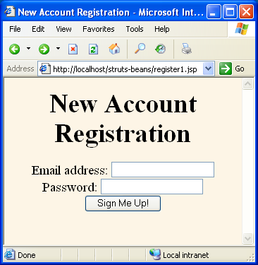
Example 1: Results (Initial Form)

Slide 73
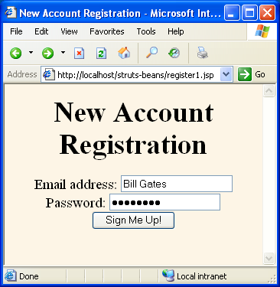
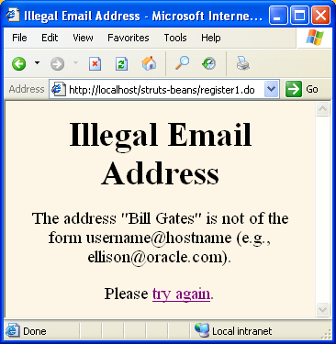
Example 1: Results
(Illegal Address)

Slide 74
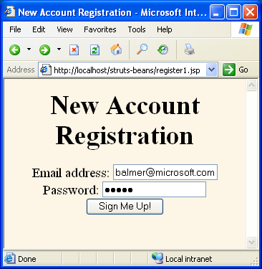
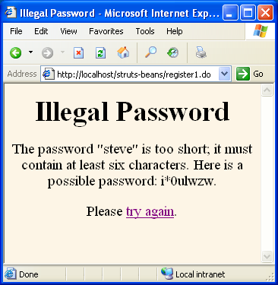
Example 1: Results
(Illegal Password)

Slide 75
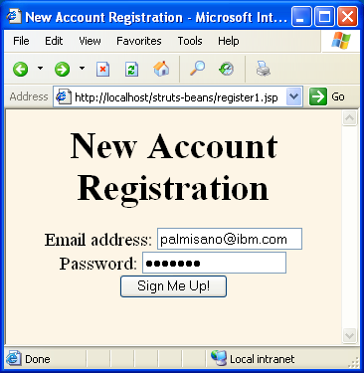
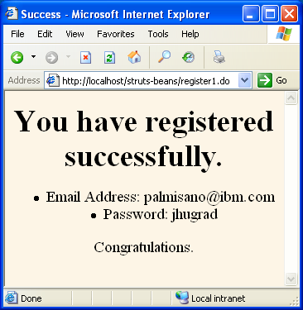
Example 1: Results
(Legal Address and Password)

Slide 76
Using the JSP 2.0 Expression Language with Struts
Pros
  The JSP 2.0 EL is shorter, clearer, and more powerful
Cons
  The bean:write tag filters HTML chars
  There is no EL equivalent of bean:message
  The EL is available only in JSP 2.0 compliant servers
    E.g., Tomcat 5 or WebLogic 9, not Tomcat 4 or WebLogic 8.x
    JSP 2.0 compliance list: http://theserverside.com/reviews/matrix.tss
To use the EL, use servlet 2.4 version of web.xml:
  You also must remove the taglib entries
<?xml version="1.0" encoding="ISO-8859-1"?>
<web-app xmlns="http://java.sun.com/xml/ns/j2ee"
xmlns:xsi="http://www.w3.org/2001/XMLSchema-instance"
xsi:schemaLocation=
"http://java.sun.com/xml/ns/j2ee web-app_2_4.xsd"
version="2.4">
…
</web-app>

Slide 77
Struts Example: Confirmation Page (Classic Style)
…
Congratulations. You are now signed up for the
Single Provider of Alert Memos network!
<%@ taglib uri="http://struts.apache.org/tags-bean"
prefix="bean" %>
<UL>
<LI>First name:
<bean:write name="contactFormBean" property="firstName"/>
<LI>Last name:
<bean:write name="contactFormBean" property="lastName"/>
<LI>Email address:
<bean:write name="contactFormBean" property="email"/>
<LI>Fax number:
<bean:write name="contactFormBean" property="faxNumber"/>
</UL>
…

Slide 78
Struts Example: Confirmation Page (JSP 2.0 Style)
…
Congratulations. You are now signed up for the
Single Provider of Alert Memos network!
<UL>
<LI>First name: ${contactFormBean.firstName}
<LI>Last name: ${contactFormBean.lastName}
<LI>Email address: ${contactFormBean.email}
<LI>Fax number: ${contactFormBean.faxNumber}
</UL>
…

